Slide 1
Designing Enterpreneurship Solutions
Polonca CENTA,
Gimnazija Novo mesto (SLO)
Zonguldak, 21. 2. 2023

Slide 2
TASK 1: Let‘s warm up …

Slide 3
Designing Enterpreneurship Solutions
Every solution is an answer to a … ?
Problem * Challenge * Issue * Need
Fixed mindset vs growth mindset.
close-minded & open-minded
rigid or fixed & adaptable

Slide 4
What is an enterpreneurship solution?
Theory vs. Reality?
„A business solution is a combination of ideas used to help a company achieve its objectives. Some relevant solutions include technology evaluation, strategic planning and the synthesis of complex business information.“
„A business solution is a combination of ideas used to help a company achieve its objectives.“
Enterpreneurship solution adresses any problem the enterprise has or faces.

Slide 5
How to detect a problem?
Business Ecosystem Mapping
How to apply the tool?
Step 1: Define what you are mapping
Step 2: Create Stakeholder Cards
Step 3: Organise stakeholders
Step 4: Draw the most important flows
Step 5: Analyse
When to apply the tool?
‘Problem Preventers’ Will Get Ahead of the Game

Slide 6
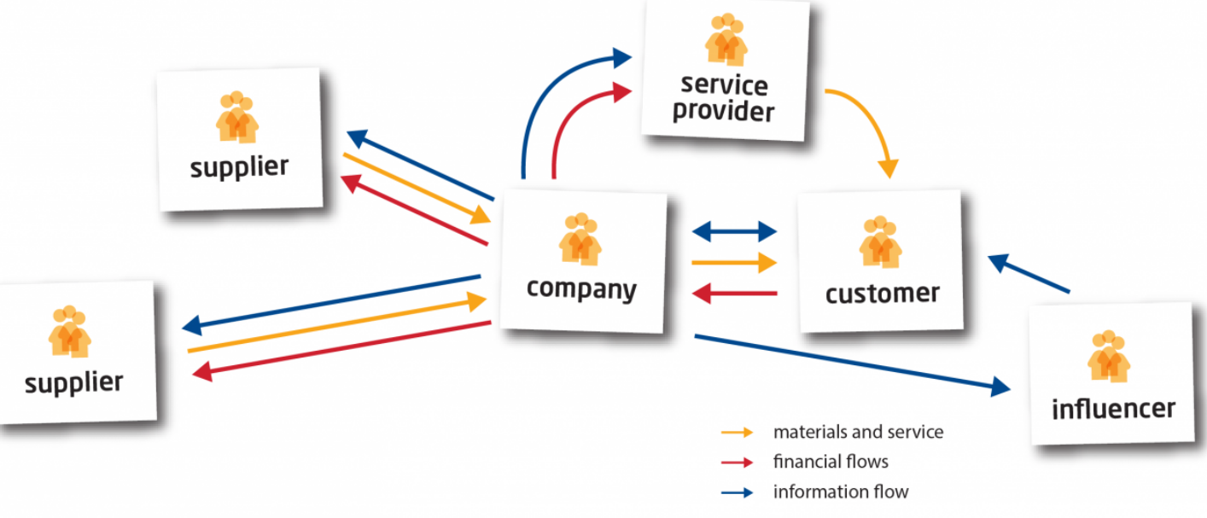
Business Ecosystem Mapping
To get insight into your current stakeholders. (interactions your company and both the up- and downstream stakeholders)
https://circitnord.com/tools/business-ecosystem-mapping/#:~:text=The%20Business%20Ecosystem%20Mapping%20tool,the%20up%2D%20and%20downstream%20stakeholders.

Slide 7
Strategy: How to tackle a problem?
Embrace the need for change.
Don‘t panic but act.
Analyse.
Find resources.
Revise. Rethink. Redo.
As many times as necessary.

Slide 8
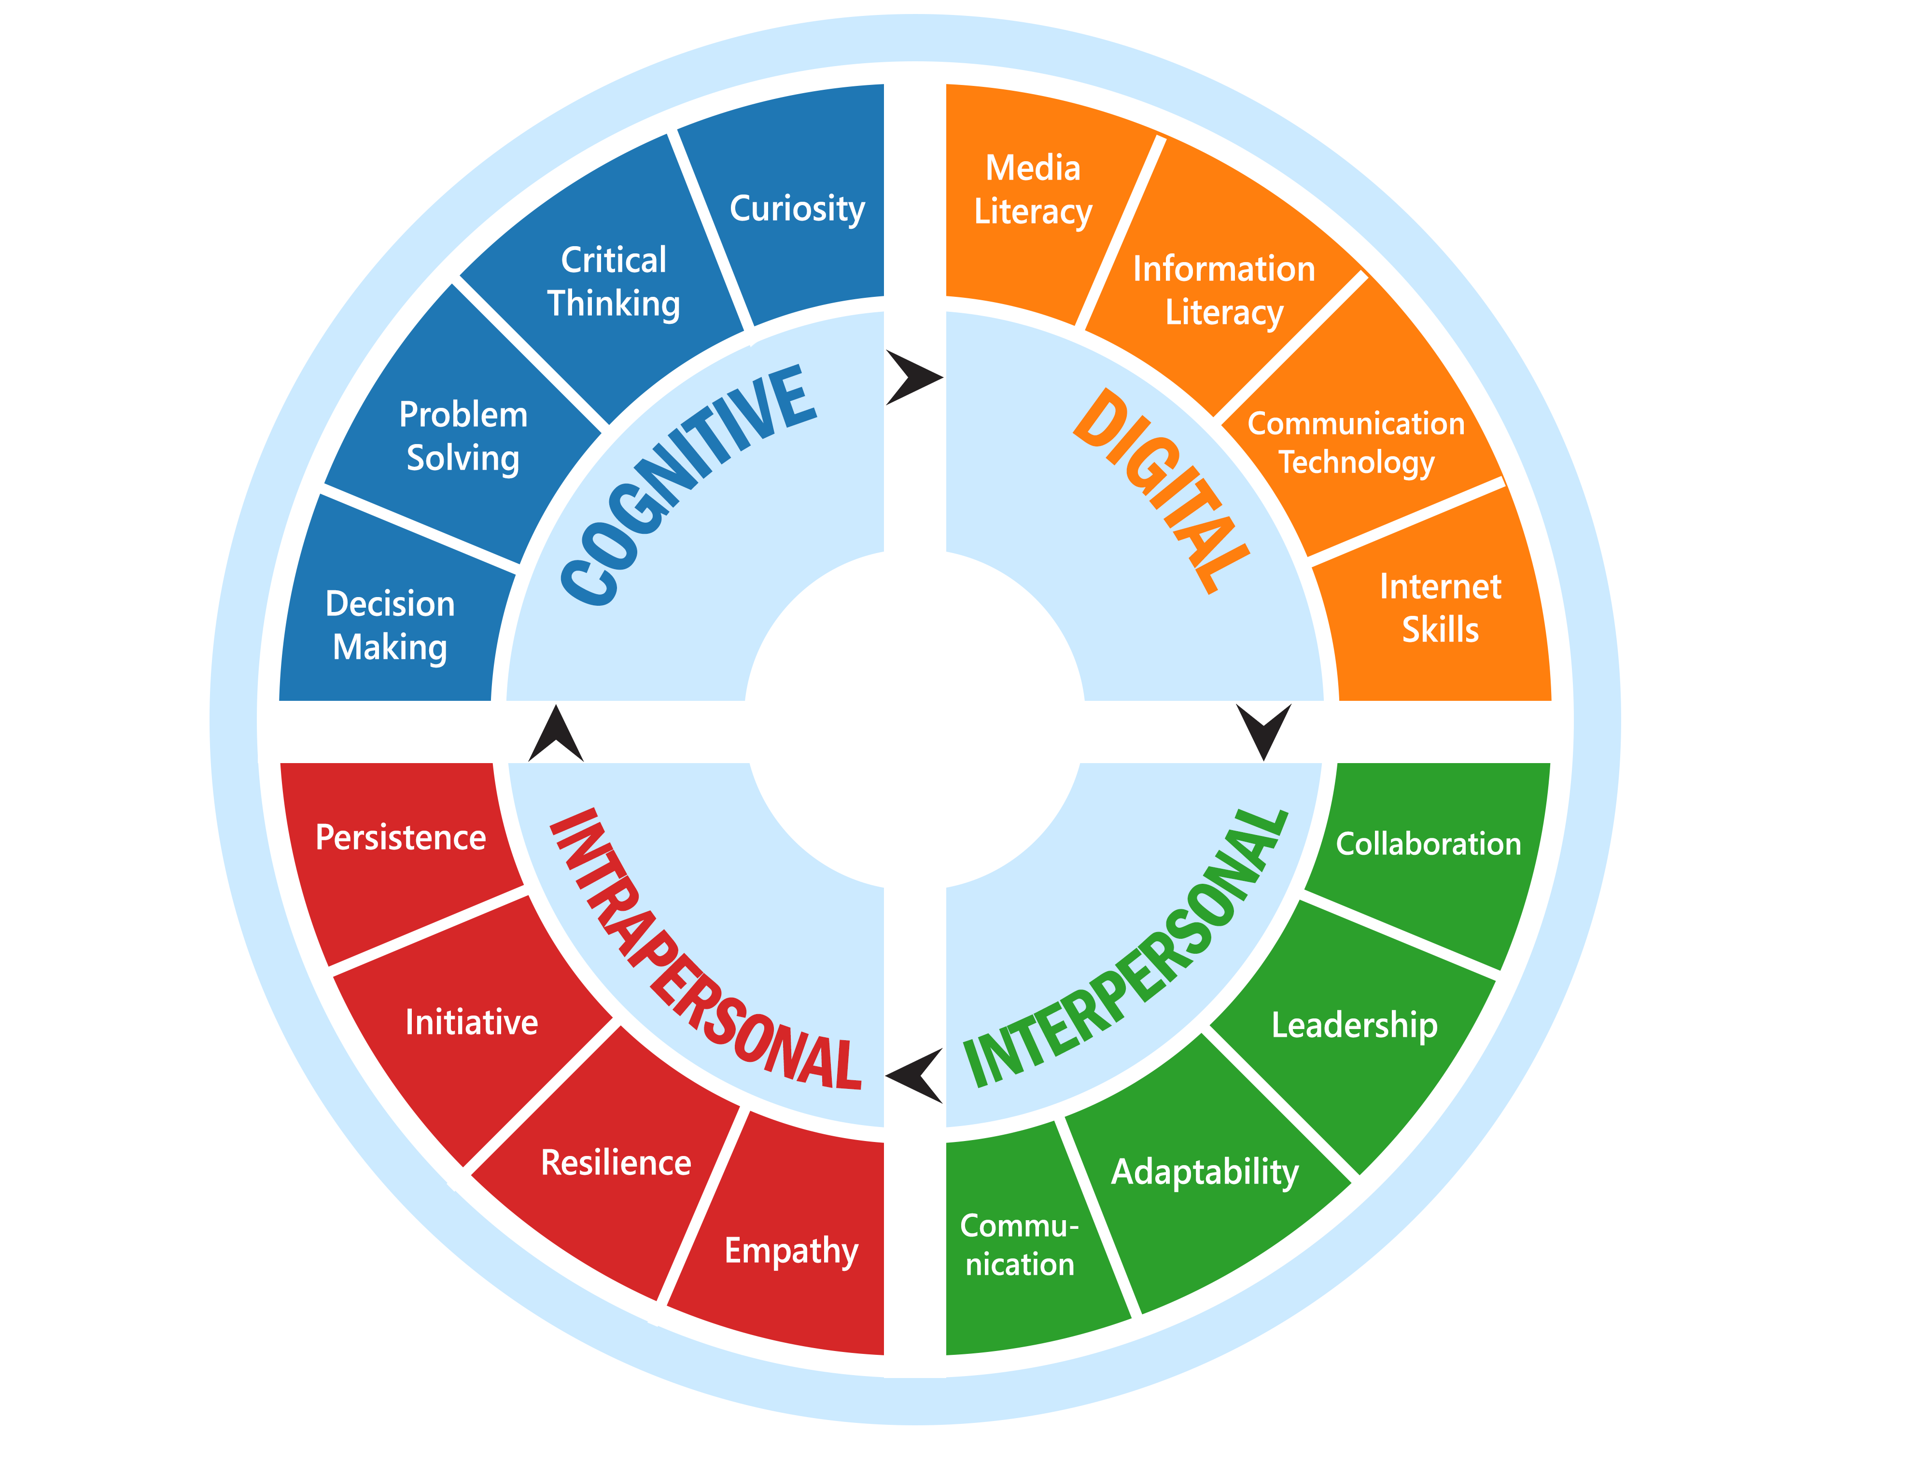
Enterpreneurship Solutions & 21st century skills for success
21st century skills for success

Slide 9
Why is critical thinking important?

Slide 10
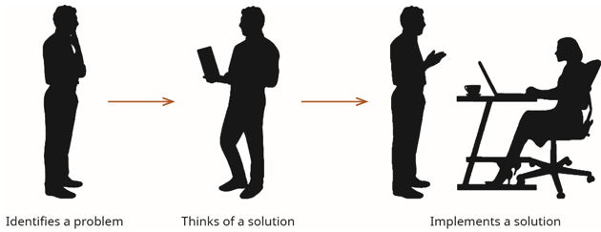
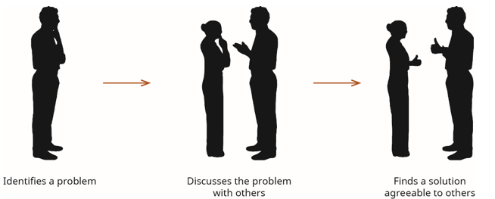
Entrepreneurial problem solving
is the process of using innovation and creative solutions to close that gap by resolving societal, business, or technological problems
personal problems can lead to entrepreneurial opportunities

Slide 11
Where in enterprise can the problems appear?
Resources
(premises / offices, raw materials, employees…)
Money flows
Marketing and advertising
Organization
IT problems
How to identify the problem? … BMC examples

Slide 12
2. Business Model Canvas (BMC) for eBay

Slide 13
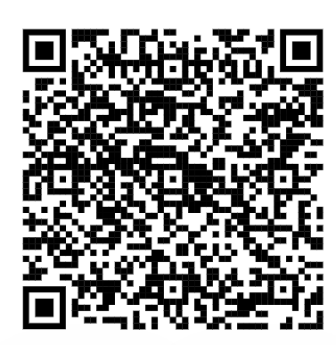
TEAM WORK: Identify the problem and provide the solution.
Each group is assigned a task.
Scan QR code.
Open the folder with your group number.
Each folder contains four (4) business model
canvas (BMC) examples.

Slide 14
3. WORKSHOP FEEDBACK

Slide 15
4. WORKSHOP EVALUATION
www.menti.com
5236 8475

Slide 16
Resorces:
https://businessjargons.com/social-entrepreneurship.html
https://iamkanikamodi.medium.com/steps-to-develop-problem-solving-skills-f9c37dd2cbdc
https://www.forbes.com/sites/annapowers/2018/12/07/connecting-the-dots-the-link-between-innovation-and-open-mindedness-with-insights-from-science/?sh=fd3df1c72956
https://circitnord.com/tools/business-ecosystem-mapping/#:~:text=The%20Business%20Ecosystem%20Mapping%20tool,the%20up%2D%20and%20downstream%20stakeholders
https://productmanagementuniversity.com/definition-of-a-business-solution/
https://openstax.org/books/entrepreneurship/pages/6-3-design-thinking
Portions of the material in this section are based on original work by Geoffrey Graybeal and produced with support from the Rebus Community. The original is freely available under the terms of the CC BY 4.0 license at https://press.rebus.community/media-innovation-and-entrepreneurship/.

