Slide 1
DRPDNM 4th sector in social entrepreneurship
ETCO: LTTA2
Hodmezovasharely, 27. 6. – 1. 7. 2022

Slide 2
OVERVIEW
Fourth sector: what it is, characteristics and examples
What is the fourth sector?
The three traditional sectors
First Sector: Private Companies
Second Sector: Governments and Public Administrations
Third Sector: Civil Society and NGOs
Characteristics of the Fourth Sector
Examples of the Fourth Sector

Slide 3
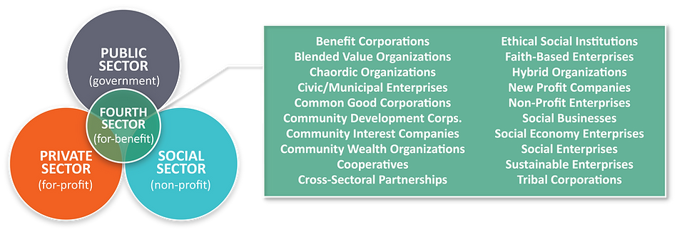
The fourth sector comprises what are sometimes referred to as “purpose-driven” or “for-benefit” enterprises. These include cooperatives, social enterprises, public benefit corporations, community development banks and community interest companies, among many others.

Slide 4
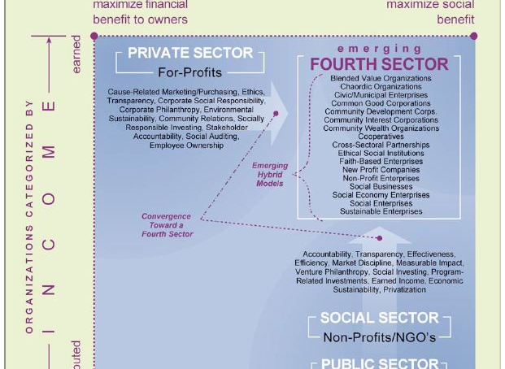
The transfer from private to emerging 4th sector

Slide 5
The NEW Sector
Social Entrepreneurship is a fourth new sector which is different from the existing three sectors (Public, Private, and the so called Third Sector).
The word entrepreneurship entails the creation of something new, which makes for the differentiation of the other three existing sectors.

Slide 6
IDEA BORN IN ASPEN, 2009
The Aspen Institute in 2009 presents the report "The Emerging fourth sector", in which they lay the foundations of what is known as the fourth sector. Part of the definition of the 3 traditional economic sectors:
1. Private businesses
2. Governments and Public Administrations
3. Civil society and NGOs

Slide 7
Characteristics
The Fourth Sector is a new model of "hybrid" companies that not only have economic benefit objectives, but also have social development objectives.
These new companies do not fit completely into one of those 3 definitions, as a result they are an intersection between the public, private and social sectors, defining a business framework with ethical values.

Slide 8
The three traditional sectors
First Sector: Private Companies
Made up of for-profit companies, which generate their income through the sale of goods and services in the market and therefore mainly seek to enrich their owners and investors.

Slide 9
Second Sector: Governments and Public Administrations
Composed of government entities that generate their income primarily through taxes and seek to create public goods, public services, and the rule of law for the benefit of citizens within their jurisdictions.

Slide 10
Third Sector: Civil Society and NGOs
Made up of non-profit organizations and non-governmental organizations that generate their income primarily through private donations and government contracts and seek to respond to pressing social problems, environmental and charity.

Slide 11
Therefore, each of these sectors has its own legal definitions and its own support systems (in reality, “ecosystems well-developed and interlinked support systems) to meet your unique set of needs and challenges.

Slide 12
The Idea
The Aspen Institute has defined 2 attributes as the principles of internal in the core structure of an organization of the Fourth Sector.
The Social Purpose: The organization must have a core commitment to a social purpose and therefore embedded in its organizational structure.
Business Methods: The organization can conduct any activity legally business, but that is consistent with its social purpose and with the responsibility of itsstakeholders.
In addition to these two attributes, The Aspen Institute defines seven characteristics that must be present in Fourth Sector organizations. For example:

Slide 13
The 7 characteristics defining 4th sector
Inclusive Property
Stakeholder Governance
Fair compensation
Reasonable Earnings
Transparency
Protection of your assets
Social Responsibility and Environmental

Slide 14
Examples of the 4th sector
social business organizations
Business organizations sustainable
common good corporations
Mixed Value Organizations
Non-profit business organizations
social enterprises
Community welfare organizations
Ethical social institutions
New for-profit companies
Faith-based business organizations
Civic/municipal business organizations
Multi-sector associations
Community Interest Corporations
"Chaordic" organizations (chaos-order)
Social economy business organizations
Community Development Corporations

Slide 15
Good practices in the 4th sector
DRPDNM‘s Workshop – Working in groups ☺

Slide 16
Creating good practices
Fourth sector of the economy is emerging, one that combines market-based approaches of the private sector with the social and environmental aims of the public and non-profit sectors to address pressing problems.
Working in groups, you will create an example of a good practice yourself and present it to others.
Phases of work:
1. Study (30 min)
2. Discuss ideas (15 min)
3.Choose and Develope one idea (30 min)
4. Create a business plan (15 min)
5. Present (30 min)

Slide 17
Thank you for your attention ☺

